Slide 1

Industrial/Organizational Psychology: An Applied Approach, 9e
Chapter 2: Job Analysis and Evaluation
Michael G. Aamodt, Industrial/Organizational Psychology: An Applied Approach, 9th Edition. © 2023 Cengage. All Rights Reserved. May not be scanned, copied or duplicated, or posted to a publicly accessible website, in whole or in part.

Slide 2
Icebreaker
Break into pairs of students.
Select a job title that you and your partner are familiar with (e.g., barista, bank teller), and list 5 tasks that are required of that job.
Present your job title and tasks to the class.

Slide 3
Learning Objectives
By the end of this chapter, you should be able to:
02-01 Explain the definition and uses of job analysis
02-02 Create a job description
02-03 Describe the job analysis process
02-04 Differentiate the various job analysis methods
02-05 Describe the job evaluation process
02-06 Explain the concept of pay equity

Slide 4
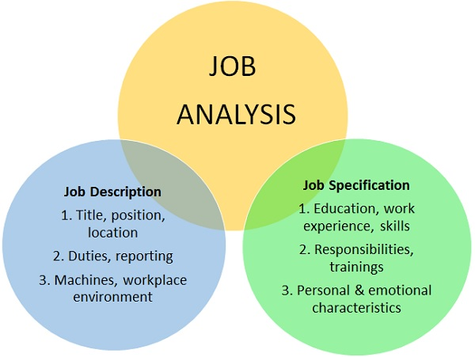
Job Analysis
Notes:
Job analysis is the process of studying a job to determine which activities and responsibilities it includes, its relative importance to other jobs, the qualifications necessary for performance of the job and the conditions under which the work is performed.
https://www.shrm.org/resourcesandtools/tools-and-samples/toolkits/pages/performingjobanalysis.aspx

Slide 5
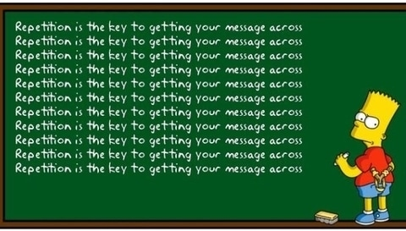

Slide 6
Importance of Job Analysis
Writing job descriptions
Employee selection
Training
Personpower planning
Performance appraisal
Job classification
Job evaluation
Job design
Compliance with legal guidelines
Organizational analysis

Slide 7
Job Description Sections
Job title
Brief summary
Work activities
Tools and equipment used
Job context
Work performance
Compensation information
Job competencies

Slide 8
Job Title
Describes the nature of the job
Assists in employee selection and recruitment
Affects perceptions of job worth and status
Job evaluation results
Employee feelings of personal worth

Slide 9
Would You Like to Upsize That Title?
Traditional Title | Upsized Title
Writer | Sentence Engineer
Waiter | Customer-Chef Intermediary
Garbage Collector | Sanitation Engineer
Secretary | Power Behind the Throne
Window Washer | Optical Illuminator Enhancer
File Clerk | Data Storage Specialist
Receptionist | Director of First Impressions
Grave Digger | Cadaver Disposal Facilitator

Slide 10
Brief Summary
Should be written in an easy to understand style
Describes the nature and purpose of the job
Used in internal and external job postings

Slide 11
Work Activities
Lists tasks and activities involving the worker
List only one activity per statement
Statements should be able to “stand alone”
Should be written in an easy to understand style
Use precise rather than general words
“Responsible for”
“Oversees”
“Handles accounts”
Should be organized into meaningful categories
Similar activities
Similar KSAOs
Temporal order

Slide 12
Tools and Equipment Used
Lists all tools and equipment used to perform the work activities
Primarily used for employee selection and training

Slide 13
Job Context
Important for applicants with disabilities to determine if they are able to perform the job under specific circumstances
Job environment
Work schedule
Degree of supervision
Ergonomic information
Stress level
Temperature
Degree of danger
Physical demands

Slide 14
Work Performance
Describes how performance is evaluated
This section might include
Standards used
Frequency of evaluation
Evaluation dimensions
The person doing the evaluating

Slide 15
Compensation Information
Exempt status
Salary grade
Other compensable factors used to determine salary

Slide 16
Job Competencies
Common Names
Job specifications
Job competencies
Knowledge, skill, ability, and other characteristics (KSAOs)
Competencies should be separated
Those needed before hire
Those that can be learned after hire

Slide 17
Workbook exercise 2.1
Let’s explore

Slide 18
Writing a Job Description
Exercise 2.2

Slide 19
Who Will Conduct the Job Analysis?
Human Resources
Job incumbents
Supervisors
External consultants
Interns/class projects

Slide 20
How Often Should a Job Description Be Updated?
How often a job changes significantly
e.g., high-tech jobs vs. package handling
Job crafting

Slide 21
Which Employees Should Participate?
Choices
All employees
Random sample
Representative sample
Convenience sample
Potential Differences
Job competence
Race
Gender
Education level
Personality
Viewpoint

Slide 22
What Types of Information Should Be Obtained?
Level of Specificity
e.g., “tilts arm at a 90-degree angle” vs. “makes financial decisions”
Types of Requirements
Formal
Informal

Slide 23
Conducting a Job Analysis Basic Steps
Step 1: Identify tasks performed
Step 2: Write task statements
Step 3: Rate task statements
Step 4: Determine essential KSAOs
Step 5: Select tests to tap KSAOs

Slide 24
Step 1: Identify Tasks Performed
Gathering existing information
Interviewing subject matter experts (SMEs)
Individual interviews
SME conferences
Ammerman technique
Observing incumbents
Job participation

Slide 25
Step 2: Write Task Statements: Elements
Required elements to a task statement
Action
Object
Optional elements
Where the task is done
How it is done
Why it is done
When it is done

Slide 26
Step 2: Write Task Statements: Characteristics
Characteristics of well-written task statements
One action and one object
Appropriate reading level
The statement should make sense by itself
All statements should be written in the same tense
Should include the tools and equipment used to complete the task
Task statements should not be competencies
Task statements should not be policies
Makes sense by itself
Indicates level of decision-making authority (when needed)

Slide 27
Task Statements Example
Poorly written task statement | Properly written task statement
Sends purchase requests | Sends purchase requests to the purchasing department using campus mail
Drives | Drives a five-speed truck to make food deliveries within the city of Toledo
Locks hall doors | Uses master key to lock hall doors at midnight so that nonresidents cannot enter the residence hall

Slide 28
Activity: Discussion
What is wrong with these task statements?
Handles customer complaints
Type, files, and distributes correspondence
Utilizes decision-making skills and abilities
In charge of the copy machine
Uses the computer to balance department budget
Responsible for opening and closing the office
Greets visitors
Examines supervisor’s daily schedule
Oversees the office

Slide 29
Step 3: Rate Task Statements
Task analysis
Research shows only two scales are necessary
Frequency
Importance

Slide 30
Rating Scale
Frequency
0 | Task is not performed as part of this job
1 | Task is seldom performed
2 | Task is occasionally performed
3 | Task is frequently performed
Importance
0 | Unimportant: There would be no negative consequence if the task were not performed or not performed properly.
1 | Important: Job performance would be diminished if task were not completed properly.
2 | Essential: The job could not be performed effectively if the incumbent did not properly complete this task.

Slide 31
Using the Ratings
Create a chart summarizing the ratings
Add the frequency and importance ratings to form a combined rating for each task
Include the task in the final task inventory if:
Average rating is greater than .5 for both frequency and importance {or}
Combined rating is 2.0 or higher

Slide 32
Task Ratings Example
Task # | Raters: Scully: F | Raters: Scully: I | Raters: Scully: CR | Raters: Mulder: F | Raters: Mulder: I | Raters: Mulder: CR | Combined Average: F | Combined Average: I | Combined Average: CR
1 | 2 | 0 | 2 | 3 | 0 | 3 | 2.5 | 0.0 | 2.5
2 | 2 | 2 | 4 | 2 | 1 | 3 | 2.0 | 1.5 | 3.5
3 | 0 | 0 | 0 | 0 | 0 | 0 | 0.0 | 0.0 | 0.0
4 | 3 | 2 | 5 | 3 | 2 | 5 | 3.0 | 2.0 | 5.0

Slide 33
Step 4: Determine Essential KSAOs
Knowledge | A body of information needed to perform a task
Skill | The proficiency to perform a certain task
Ability | A basic capacity for performing a wide range of different tasks, acquiring knowledge, or developing a skill
Other characteristics | Personal factors such as personality, willingness, interest, and motivation and such tangible factors as licenses, degrees, and years of experience

Slide 34
Workbook exercise 2.3
Let’s explore

Slide 35
Competency | KSAO
1. Data entry speed | Skill
2. Finger dexterity | Ability
3. Driving a car | Skill
4. Traffic rules | Knowledge
5. A driver’s license | Other
6. A friendly personality | Other
7. Ten years of experience | Other
8. Basic intelligence | Ability

Slide 36
Competency | KSAO
9. Physical strength | Ability
10. Color vision | Ability
11. Being a nonsmoker | Other
12. Customer service experience | Other
13. Use of PowerPoint | Skill, knowledge
14. Willingness to work weekends | Other
15. Spelling and grammar | Skill, knowledge
16. Writing reports | Skill

Slide 37
Step 5: Selecting Tests to Tap KSAOs
Determine best method to tap KSAOs at time of hire
e.g., interviews, work samples, tests, biodata, assessment centers
Used to select new employees

Slide 38
Methods Providing General Information About Worker Activities: PAQ
Position Analysis Questionnaire
300 Items
6 main dimensions
Information input
Mental processes
Work output
Interpersonal activities
Job context
Other
Inexpensive
Standardized
Difficult to read for average employee

Slide 39
Methods Providing General Information About Worker Activities: JSP, JEI, and FJA
Job Structure Profile
Designed as a replacement for the PAQ
Easier to read than the PAQ
Good reliability
Job Elements Inventory
153 items
10th grade readability level
Correlates highly with PAQ
Functional Job Analysis
Data
People
Things

Slide 40
Methods Providing General Information About Tools and Equipment
Job Components Inventory
More than 400 questions
5 main categories
Tools and equipment used
Perceptual and physical requirements
Mathematical requirements
Communication requirements
Decision making and responsibility
Good reliability

Slide 41
Methods Providing General Information About the Work Environment
AET (ergonomic job analysis procedure)
Concerned with the relationship between the worker and work objects
216 items

Slide 42
Methods Providing General Information About Competencies
Occupational Information Network (O*NET)
Developed to replace the Dictionary of Occupational Titles
Economic, organizational, occupational, and individual
923 occupations (2021)
Occupation, worker characteristics, and economic factors

Slide 43

Methods Providing General Information About Competencies: Critical Incident Technique
Critical Incident Technique
Job incumbents generate incidents of excellent and poor performance
Job experts examine each incident to determine if it is an example of good or poor performance
3 to 4 incumbents sort incidents into categories
Job analyst combines and names categories
3 incumbents re-sort incidents into combined categories
Number of incidents per category provides an idea of the importance of each category

Slide 44
Critical Incident Technique Example
Category (Resident Assistants) | Excellent | Poor | Total
Interest in residents | 31 | 19 | 50
Availability | 14 | 27 | 41
Responsibility | 12 | 20 | 32
Fairness | 18 | 10 | 28
Self-adherence to rules | 0 | 28 | 28
Social skills | 19 | 7 | 26
Programming | 13 | 7 | 20
Self-confidence | 12 | 8 | 20
Rule enforcement | 4 | 4 | 18
Authoritarianism | 1 | 16 | 17
Counseling skills | 12 | 4 | 16
Self-control | 5 | 2 | 7
Confidentiality | 1 | 2 | 3

Slide 45
Methods Providing General Information About Competencies: JCI and TTA
Job Components Inventory
In addition to tools and equipment used on the job, also provides information about skills needed for the job, such as:
Perceptual skills
Physical skills
Mathematical skills
Communication skills
Decision making skills
Responsibility level
Threshold Traits Analysis
33 items
5 main categories
Physical traits
Mental traits
Learned traits
Motivational traits
Social traits
Reliable
Short and quick to use

Slide 46
Methods Providing General Information About Competencies: F-JAS and JAI
Fleishman Job Analysis Survey
73 abilities
Cognitive
Physical
Psychomotor
Sensory-perceptual
Social/interpersonal
Good reliability
Detailed
Commercially available
Job Adaptability Inventory
132 items
8 adaptability dimensions
Handling emergencies
Handling work stress
Solving problems creatively
Dealing with uncertainty
Learning
Interpersonal adaptability
Cultural adaptability
Physically oriented adaptability

Slide 47
Methods Providing General Information About Competencies: Personality and Performance
Personality-Related Position Requirements Form
107 items
12 personality dimensions
Performance Improvement Characteristics
48 questions
7 main personality traits

Slide 48
Job Evaluation

Slide 50
The Ideal Compensation System
Will attract and retain desired employees
Will motivate current employees while also providing security
Is equitable
Is in compliance with legal guidelines

Slide 51
Determining Internal Pay Equity
Step 1: Determine compensable factors
Step 2: Determine levels for each factor
Step 3: Determine factor weights
Determine total number of points to distribute among factors
Assign points to each factor
Divide number of points assigned to a factor into each level
Run regression (wage trend line) to determine how well points predict salary midpoints

Slide 52
Step 1: Determining Compensable Job Factors
Compensable Factors
Examples
Level of responsibility
Physical demands
Mental demands
Education requirements
Training and experience requirements
Working conditions

Slide 53
Activity: Discussion: Job Value
What factors make one job worth more than another?

Slide 54
Step 2: Determining Levels for Each Compensable Factor
Education
High school degree or less
Two-year college degree
Bachelor’s degree
Master’s degree
Responsibility
Makes no decisions
Makes decisions for self
Makes decisions for 1-5 employees
Makes decisions for more than 5 employees
Physical demands
Lifts no heavy objects
Lifts objects between 25 and 100 pounds
Lifts objects more than 100 pounds

Slide 55
Step 3: Determining the Factor Weights
Determine total number of points to distribute among factors
Assign points to each factor
Divide number of points assigned to a factor into each level
Run regression (wage trend line) to determine how well points predict salary midpoints
Used to identify jobs that are equitable, underpaid, and overpaid using the difference between the current salary and the wage trend line

Slide 56
Determining the Factor Weights: Determine Total Number of Points
Factor | Total Points
Education | 200
Responsibility | 300
Physical demands | 90
Total | 590

Slide 57
Determining the Factor Weights: Assign Points to Each Factor
Responsibility (300 points possible) | Points
Makes no decisions | 75
Makes decisions for self | 150
Makes decisions for 1-5 employees | 225
Makes decisions for > 5 employees | 300
Total | 300

Slide 58
Determining the Factor Weights: Assign Points to Each Job
Position: Production Supervisor
Factor | Points
Education | 200
Responsibility | 300
Physical demands | 30
Total | 530

Slide 59
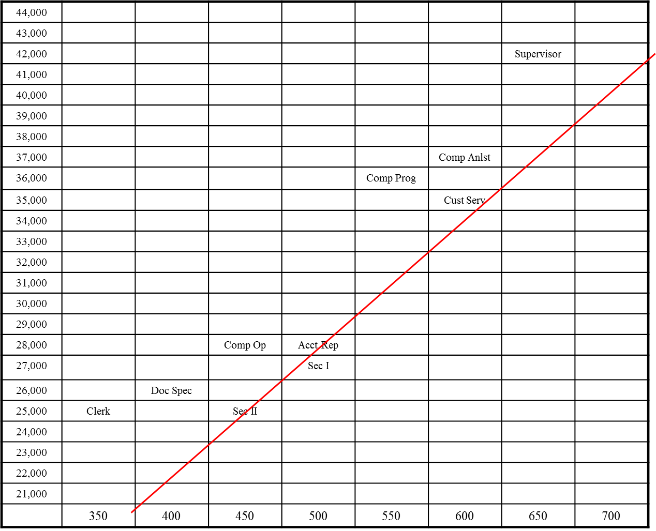
Determining the Factor Weights: Wage Trend Line

Slide 60
Wage Trend Line Analysis
Job | Points | Predicted Salary | Salary | Difference
Computer Operator | 450 | $27,869 | $28,000 | +$131
Computer Programmer | 550 | $33,936 | $36,000 | +$2,064
Documents Specialist | 400 | $24,835 | $26,000 | +$1,165
Secretary I | 500 | $30,902 | $27,000 | −$3,902
Secretary II | 450 | $27,869 | $25,000 | −$2,869
Computer Analyst | 600 | $36,969 | $37,000 | +$31
Clerk | 350 | $21,802 | $25,000 | +$3,198
Supervisor | 650 | $40,003 | $42,000 | +$1,197
Account Representative | 500 | $30,902 | $28,000 | −$2,902
Customer Service Agent | 550 | $33,936 | $35,000 | +$1,065

Slide 61
Determining External Pay Equity
Worth based on external market
Determined through salary surveys
Information obtained
salary range
starting salary
actual salaries paid
benefits

Slide 62
Salary Survey Example
 | # of orgs | # of emp | Weighted Average | Salary Range: Low | Salary Range: Q1 | Salary Range: Median | Salary Range: Q3 | Salary Range: High
Production
Foreperson | 18 | 286 | $23.21 | 12.67 | 19.96 | 22.67 | 28.69 | 37.44
Machinist | 9 | 419 | $20.83 | 10.28 | 17.79 | 19.63 | 22.09 | 26.80
Planner | 9 | 36 | $19.73 | 17.64 | 19.68 | 21.63 | 24.59 | 37.44
Production | 15 | 3,487 | $18.91 | 9.49 | 13.24 | 16.05 | 16.62 | 24.27
Quality Ins | 10 | 45 | $15.23 | 11.00 | 13.84 | 15.01 | 21.31 | 24.18
Maintenance
Janitor | 10 | 322 | $12.00 | 8.85 | 10.02 | 11.15 | 12.04 | 20.81
Maint A | 17 | 112 | $15.90 | 10.65 | 11.54 | 15.97 | 20.40 | 27.78
Mechanic | 11 | 382 | $19.80 | 12.99 | 18.10 | 19.30 | 21.27 | 25.98

Slide 63
Determining Sex, Race, and Ethnicity Equity
Salary equity studies are required because of substantial sex and race/ethnicity differences in average salary
Step 1: Similarly Situated Employee Groups (SSEG)
Step 2: Conduct statistical analyses to determine if there are significant sex or race/ethnicity differences within each SSEG after controlling for legitimate factors

Slide 64

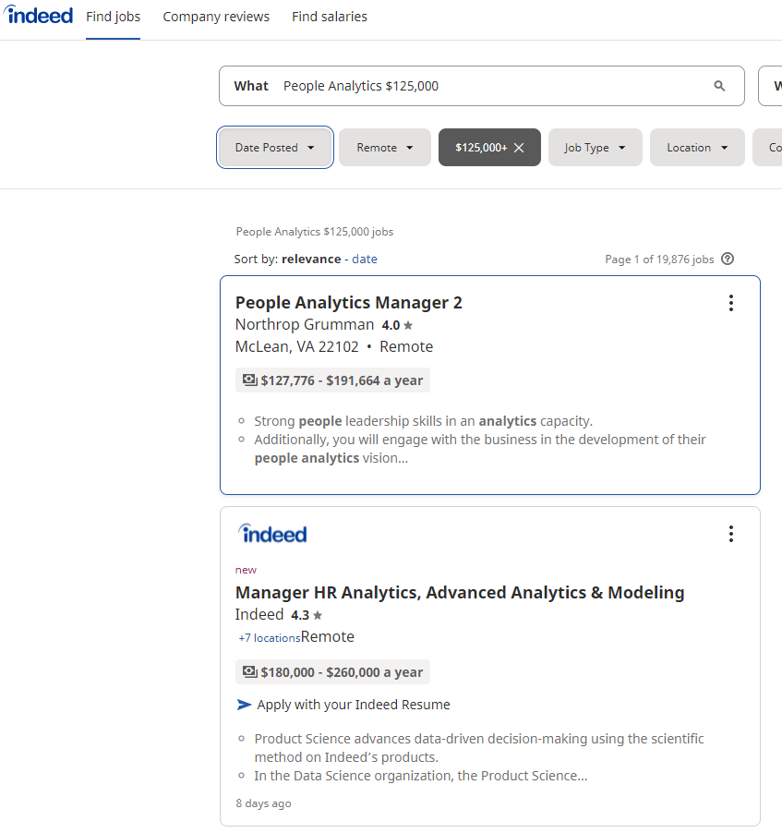
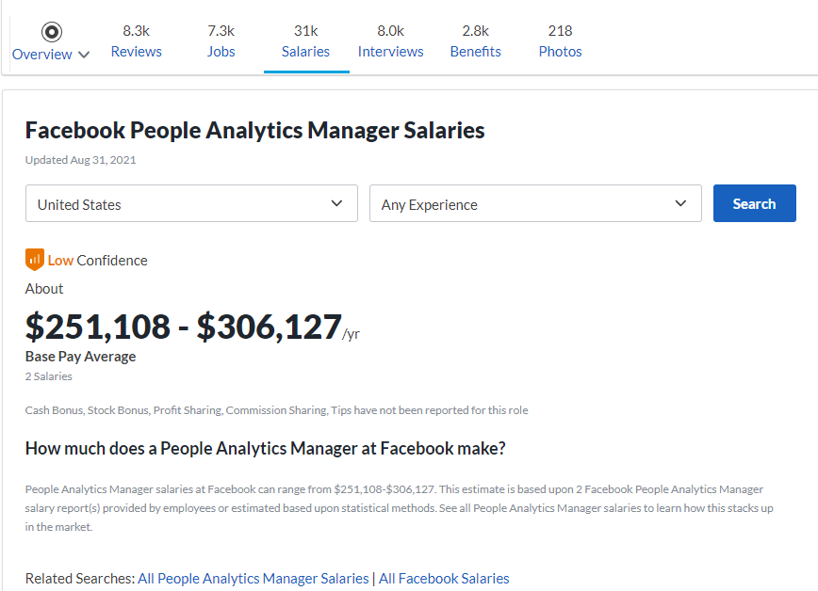

Notes:
Of those people who negotiated, they were able to increase their salary by over 7%
That may not sound like much, but as Stanford negotiation professor Margaret A. Neale puts it: If you get a $100,000 salary and your co-worker negotiates up to $107,000, assuming you’re treated identically from then on, with the same raises and promotions, you’d have to work eight years longer to be as wealthy as them at retirement.
https://www.themuse.com/advice/how-to-negotiate-salary-37-tips-you-need-to-know

Slide 65
Activity: Discussion: Focus on Ethics
Consider these questions:
Would you leave a job you like to increase your salary by 30%
Would you take a job that makes less more money but has a ‘cooler’ title?
Should job descriptions contain salary information?

Slide 66
Self-Assessment
Why is job analysis so important?
What are the main sections of a job description?
Would a job analyst expect to find gender and race differences in the way employees perform the duties of their job? Why or why not?
How should a task statement be written?
Why are there so many job analysis methods?
Research indicates that the average salary for women in the United States is about 80% the average salary for men. Why is this?
Is external pay equity more important than internal pay equity? Why or why not?

Slide 67
Summary
Now that the lesson has ended, you should have learned how to:
Explain the definition and uses of job analysis
Create a job description
Describe the job analysis process
Differentiate the various job analysis methods
Describe the job evaluation process
Explain the concept of pay equity
Notes:
Review objectives.

